Slide 1
Computer & Communication Technology
HISTORY OF COMPUTERS

Slide 2
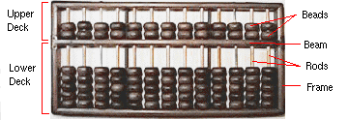
HISTORY OF COMPUTERS
Abacus (around 500 BC)
  A calculator used to add, subtract, multiply and divide by the Chinese
  Still used in some parts of Asia

Slide 3
The slide rule 1630
Based on Napier’s rule of logarithms
Napier's logarithms allowed people to do more calculations in one hour than they could previously have done in a day.
Logarithms turn complicated multiplication and division problems into addition and subtraction
They are laid out in logarithmic tables, popularly known as 'log tables'.
Used everywhere until1970s, when electronic calculators were invented.

Slide 4
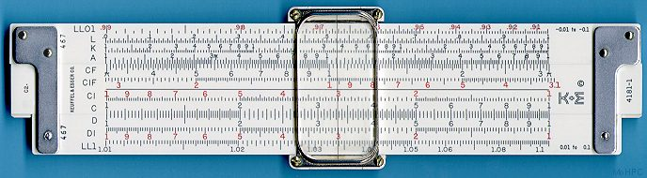

Slide 5
Jacquard Loom (19th Century
used metal cards with punched holes to guide weaving process
first stored program - metal cards
first computer manufacturing
still in use today!

Slide 6
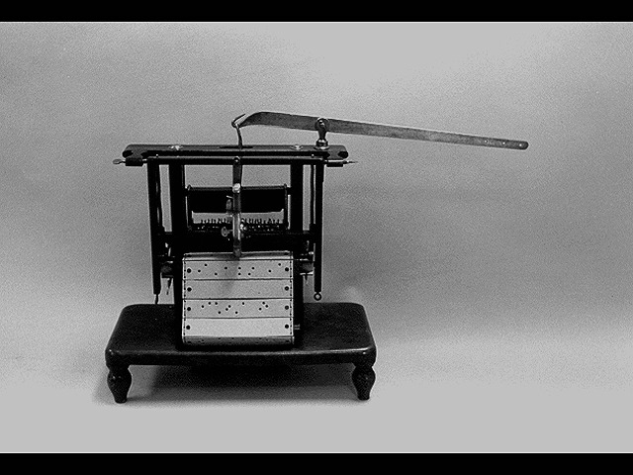
Jacquard Loom (19th Century

Slide 7
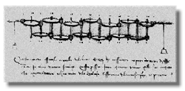
Leonardo da Vinci (1452-1519)
Made drawings of gear-driven calculating machines but apparently never built any.

Slide 8
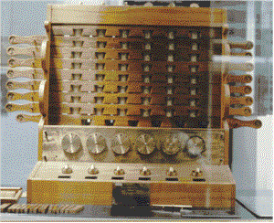
Schickard's Calculating Clock
The first gear-driven calculating machine to actually be built was the calculating clock

Slide 9
Pascaline (1642)
Invented by Blaise Pascal, at age 19 as an aid for his father who was a tax collector
A gear-driven one-function calculator (it could only add)
Couldn't sell many because of their exorbitant cost and
weren't that accurate (at that time it was not possible to manufacture gears with the required accuracy).

Slide 10
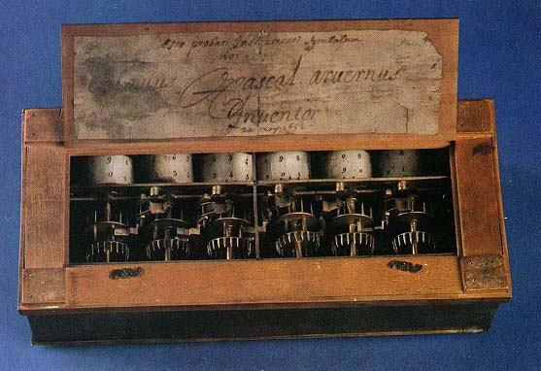
Odometer portion of a car's speedometer used the very same mechanism as the Pascaline

Slide 11
Stepped reckoner
A four-function (addition, subtraction, multiplication, and division) calculator
Built by the German, Gottfried Wilhelm Leibniz

Slide 12
Joseph Marie Jacquard (1801)
Invented a power loom that could base its weave upon a pattern read from punched wooden cards, held together in a long row by rope
By selecting particular cards for Jacquard's loom you defined the woven pattern

Slide 13
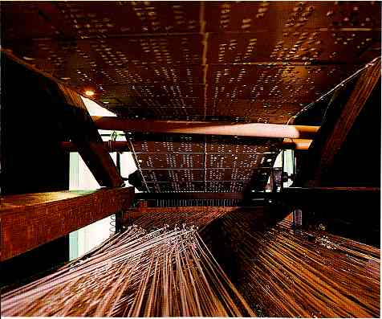

Slide 14
Difference Engine 1822
In 1822 Charles Babbage proposed a steam driven calculating machine the size of a room
machine would be able to compute tables of numbers, such as logarithm tables
He obtained government funding for this project due to the importance of numeric tables in ocean navigation powered by steam
Its construction proved exceedingly difficult and the project soon became the most expensive government funded project
Ten years later the device was still nowhere near complete and funding dried up
The device was never finished

Slide 15
